Slide 1
MySQL Training

Slide 2
What is MySQL

Slide 3

What is a database?
Notes:
Not to be overly didactic, but a database is a location where we can store data. Broadly speaking, this can include anything from files on your computer or a dropbox account to where NYSE trade data is stored or Facebook’s trillion photos

Slide 4
Notes:
One key component of databases is that they can be shared resources; you can simultaneously access the database from various locations. While there are numerous databases that are used only by one person (e.g., most programs internally use databases), this discussion focuses on their use as shared resources.

Slide 5
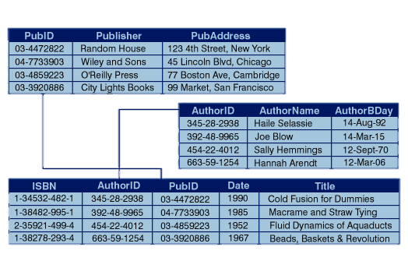
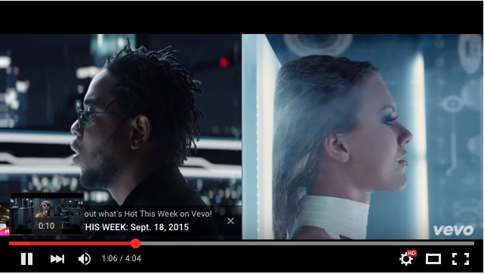
Common Database Types
Relational Databases
NoSQL
Predominantly SQL and Microsoft Access
Data generally can be expressed in a table format
Everything else. Graphs and Key-Value stores are common
id
11322141
11322142
11322143
3.14159265358979…
Relational Database
Graph Database (Facebook)
Key-value store

Slide 6
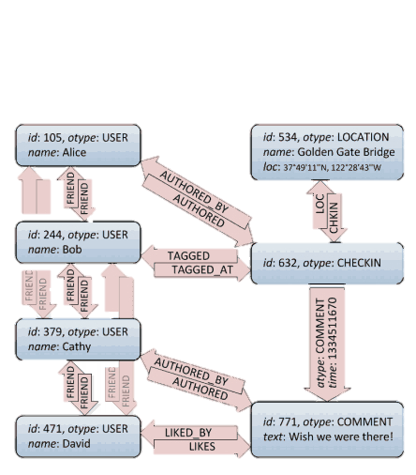
Common Database Types
Relational Databases
NoSQL
Predominantly SQL and Microsoft Access
Data generally can be expressed in a table format
Everything else. Graphs and Key-Value stores are common
id
11322141
11322142
11322143
3.14159265358979…
Relational Database
Graph Database (Facebook)
Key-value store

Slide 7
Why to use MySQL

Slide 8
SQL |  | Excel
Pros | Cons | Pros | Cons
Interfaces well with many programming languages | Steeper learning curve | Quick to start working | Difficult to replicate analysis
Easy to update data and repeat analysis | Not great for complex analysis | Able to store and analyze data | Nontrivial to update
Can maintain data integrity |  | Flexible | Difficult to scale (across data or users)
Easy to scale across data and users (within limits) |  | Able to make charts | Not great for complex analysis
Something that will differentiate you from many consultants and bankers |  | Easy to learn the basics

Slide 9
SQL Use Cases | Excel Use Cases
Monitoring a marketing campaign on an ongoing basis | Building a financial model
Analyzing user behavior on a website | Making graphs for a presentation or report
Tracking sales | To-do lists, contact lists
Tracking historical input prices

